Slide 1
Did You Know?

Slide 2
Conflict diamond wars have cost over 3.7 million lives.

Slide 3
The death toll after Sierra Leone’s civil war alone was 50,000 people.
And close to two million people in the country have been displaced.

Slide 4
An estimated 65% of the world’s diamonds come from African countries where wars such as this one take place.

Slide 5
Although Sierra Leone is littered with riches like diamonds, they are still one of the world’s poorest countries.
Ranking 203 out of 206.

Slide 6
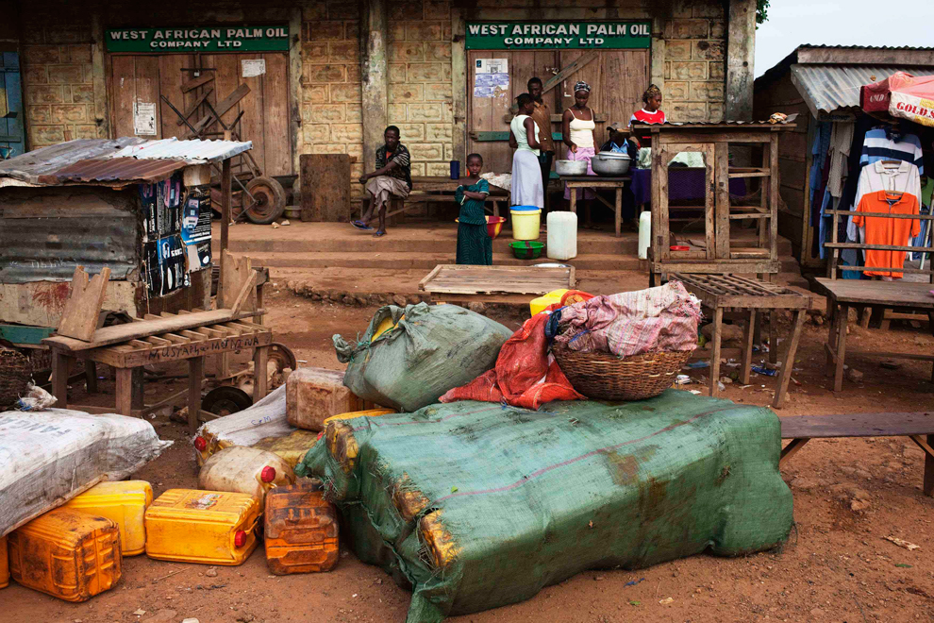

Slide 7
Do you know where your diamonds are from?
How do you know it’s not a conflict diamond?

Slide 8
Many of the world’s diamonds have been mined using child labor and other practices that are harmful to workers.

Slide 9
Most miners lack safety equipment and proper tools, so everyday they risk death & injury from landslides or mine collapses.
And for over a million of them, it’s done for less than a dollar a day

Slide 10
Children have also been forced to work.
Almost half of the miners were between the ages of 5 and 16.

Slide 11
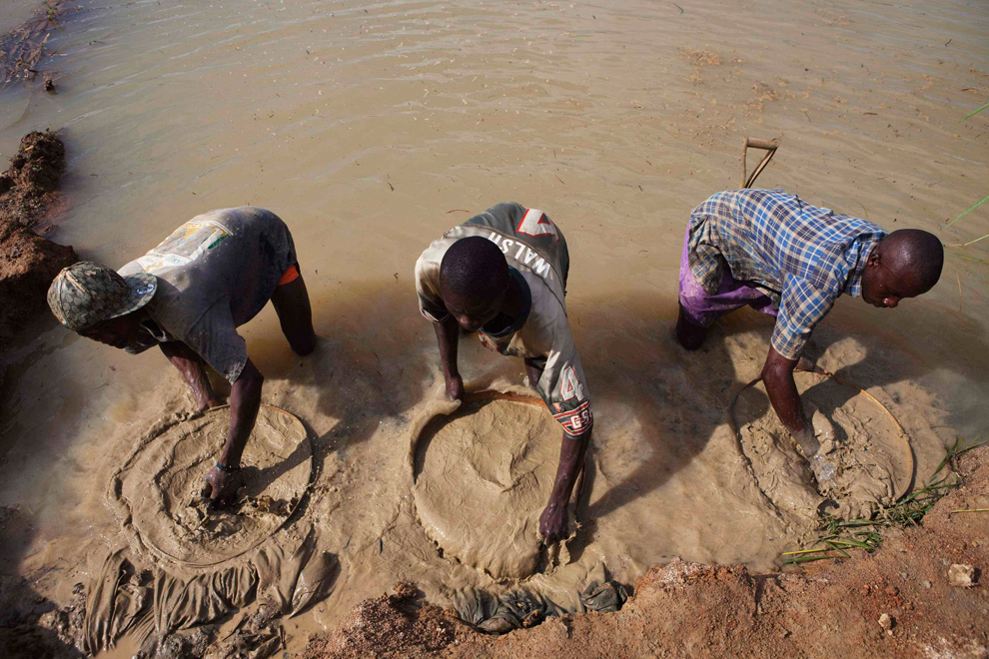

Slide 12
They worked long days and often six or seven days a week, and many child miners will not attend school.
This leaves them little choice but to continue working as miners into adulthood.

Slide 13
Forced labor isn’t uncommon in diamond mines either, adults and children were often kidnapped and trafficked into mining.

Slide 14
After working hard for these diamonds, they would be taken from the miners by the government, which would make a large profit off them.

Slide 15
And give none of the profit back to the people.

Slide 16
Instead, it went to the government and the Revolutionary United Front, a group of rebels known for the brutal acts they’d perform to show their power.
Most notably, amputating the hands and feet of their victims.
Including children.

Slide 17
The exact number of amputations that occurred is unknown.
What is known is 3 out of 4 victims would die at the scene.

Slide 18
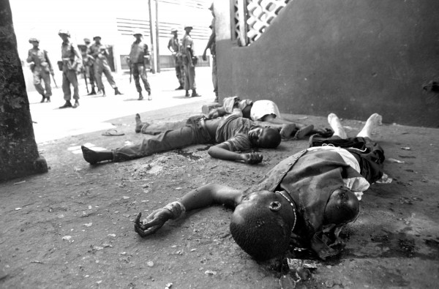

Slide 19
The RUF was also known for abducting children.
These “child soldiers” would carry military equipment and other looted goods.
Female abductees were regularly raped.

Slide 20
Of the soldiers that fought in Sierra Leone’s civil war,
6,914
were child soldiers.

Slide 21
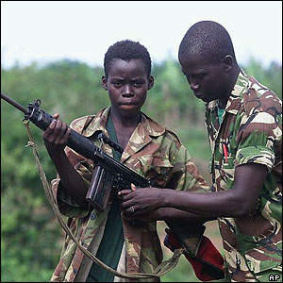

Slide 22
But, because of the Kimberly Process, an intervention implemented to stop the wars behind conflict diamonds in 2003:
Africa’s diamond industry has infused $8.5 billion into the economy.
Legally.
Conflict diamonds have been reduced from approximately 4% of the global diamond market to considerably less than 1%
5 million people have obtained health care in Africa.
Extra diamond revenues are going toward HIV/AIDS research.
But some diamond producing countries still aren’t Kimberly Process compliant…

Slide 23
So the next time you pick out a new piece of jewelry...
Make sure you know.

Slide 24
Ask your jeweler,
“Is this diamond Kimberly Process certified?”

